Slide 1
CROWDLEARNING A framework for collaborative personalized learning
Thilak Raj Balasubramanian- 101622696
(Individual Graduate Study under Dr. Trilce Estrada)

Slide 2

Motivation
Online and Remote Education- Priority for Higher Education Institutions
Current Remote learning Technologies are of rigid approach and rely on carefully curated content creation
Educators spend lots of time in content creation and students are systematically out of content creation cycle

Slide 3

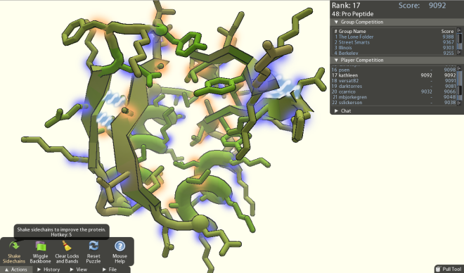
CrowdLearning
Technological Learning Framework-CrowdLearning
Crowd of students and educators generate, consume, and evaluate a large body of educative materials
Students from passive content consumers to content creators

Slide 4
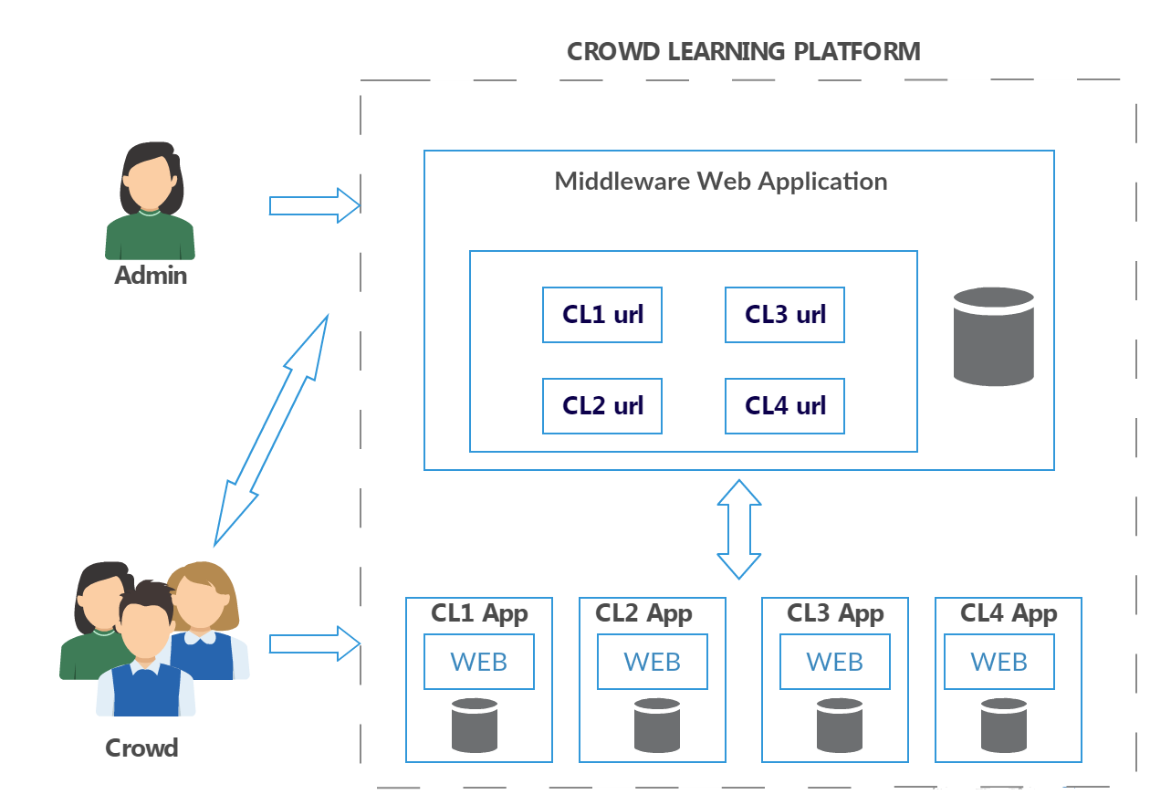
Cyber Infrastructure
Develop Cyber Infrastructure to deploy Crowd Learning Applications
A Proof of Concept(POC) of Multi modal Crowd Learning Application for Geography Learning

Slide 5
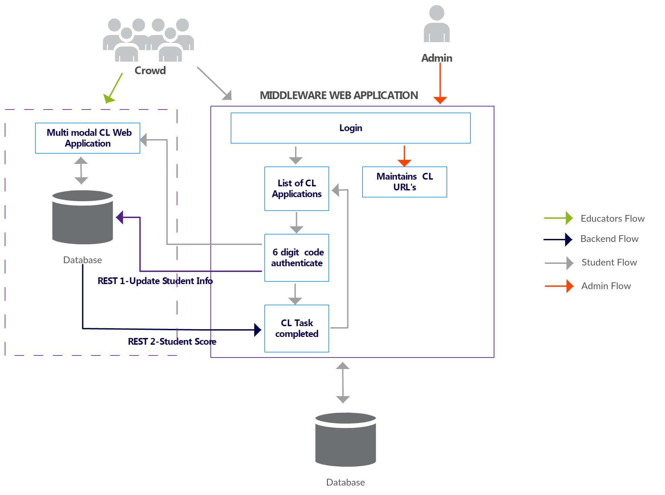
Application Flow

Slide 6
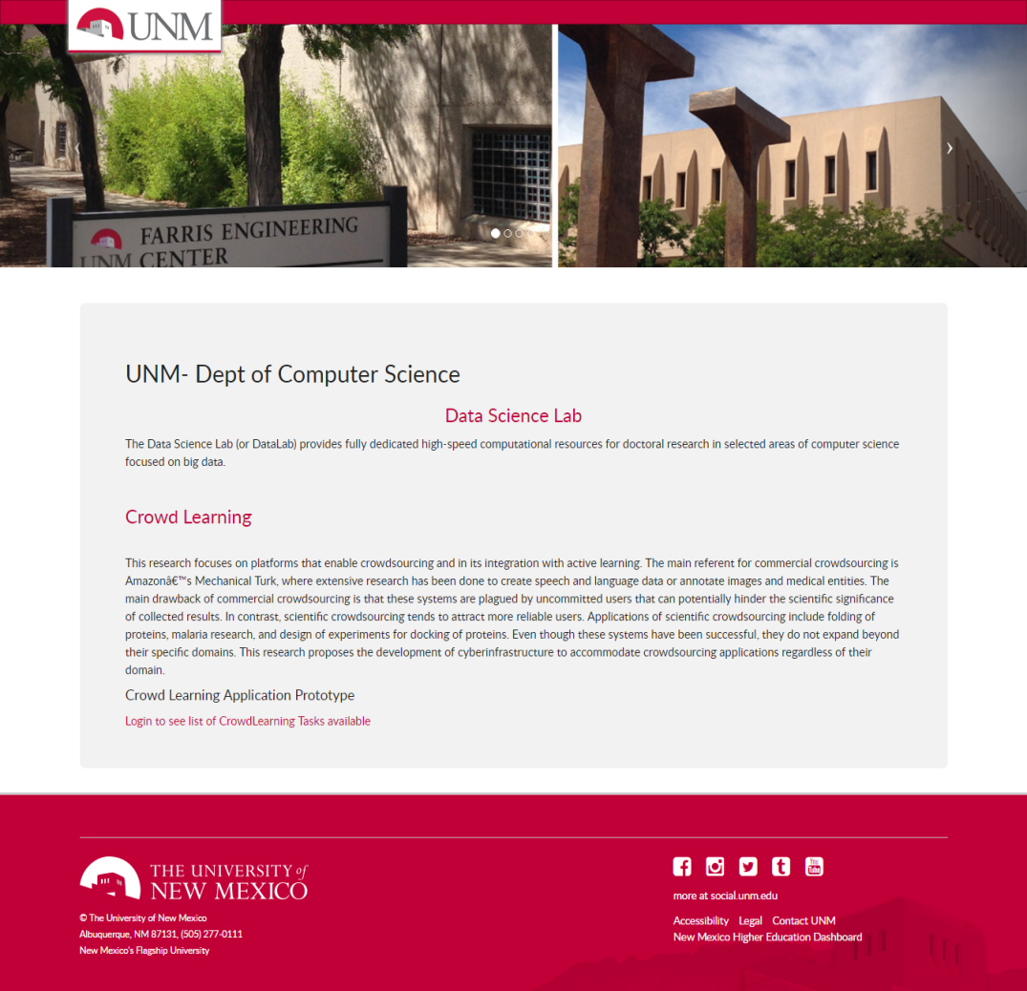
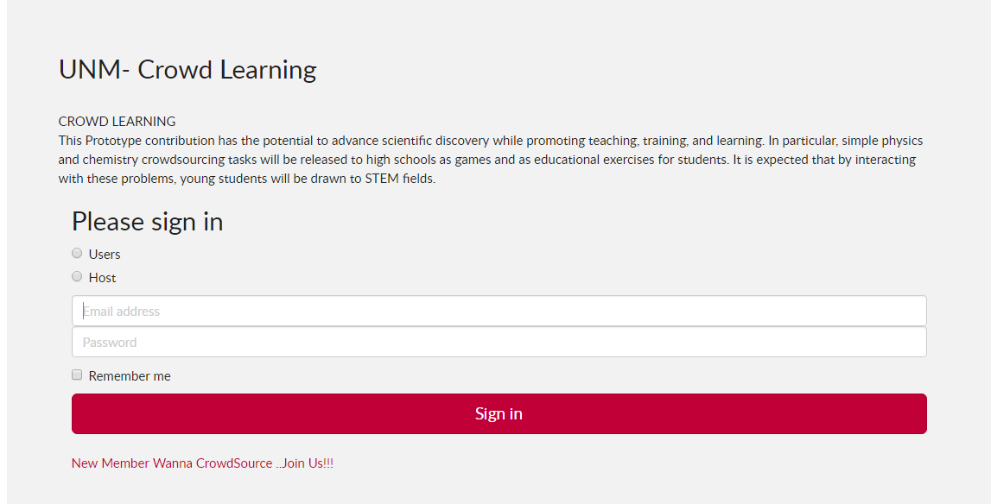
Middleware Application

Slide 7
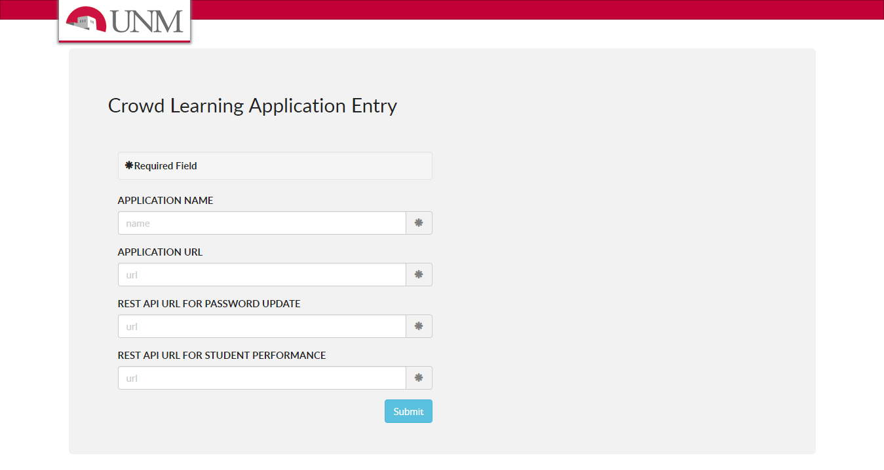

Middleware Application

Slide 8
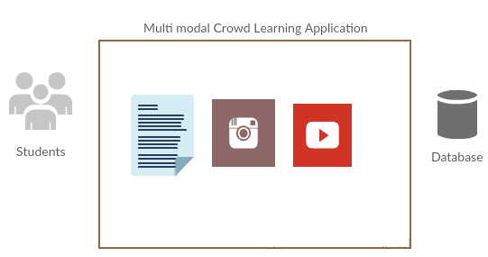
CrowdLearning Application-POC
Multi modal Crowd Learning Application for Geography Learning
A quiz to identify mountains, volcanoes and other geographic information
Collect feedback and suggestions on each question from User

Slide 9
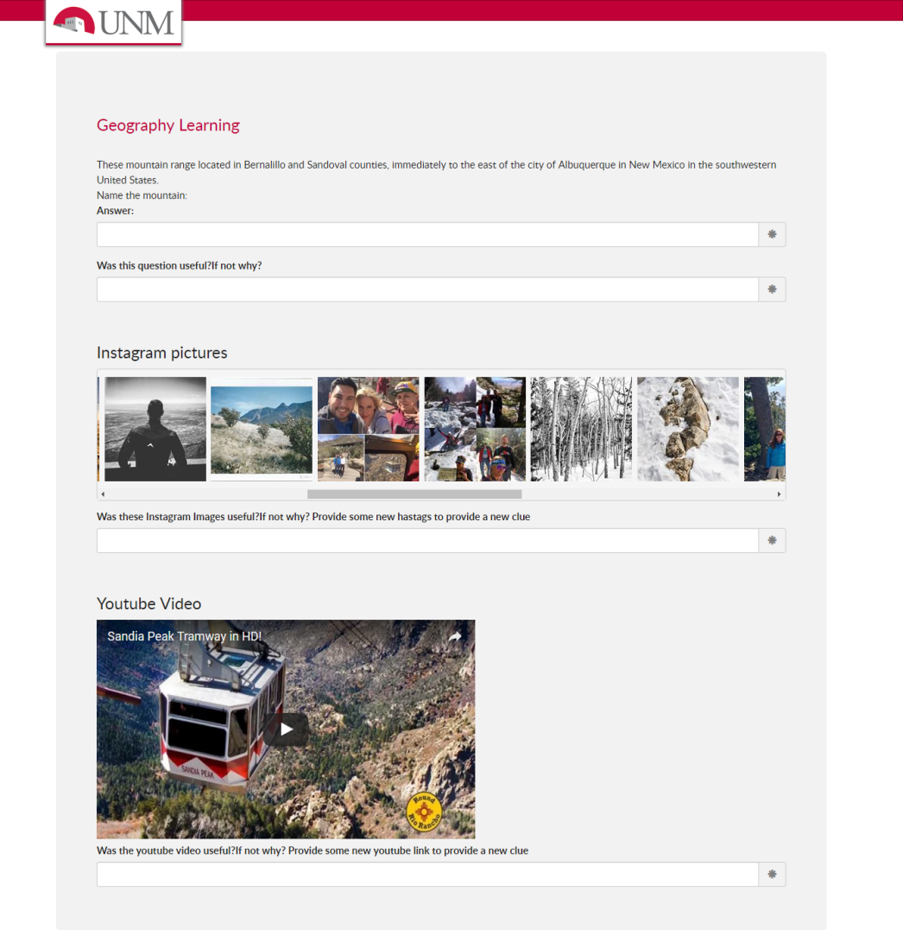
CrowdLearning POC
Provide Clues as Instagram Images and YouTube videos
Collect feedback
Track User behavior

Slide 10




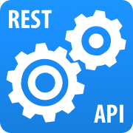


Middleware & CL POC Specification
Developed using Java MVC and Hibernate Framework.
MySQL Database
REST API and JSON
UI-Bootstrap
Embedded YouTube videos
Instagram Images are retrieved from Instagram API using Instafeed.js

Slide 11
Future Work
Building Recommendation system on the tracked user behavior
More efficient and secured way of redirecting CrowdLearning urls

Slide 12
References
http://softwarecrowdsourcing.wikispaces.asu.edu/Process,architecture+and+verification
Alicia Fornés, Josep Lladós, Joan Mas, Joana Maria Pujades, and Anna Cabré. 2014. A bimodal crowdsourcing platform for demographic historical manuscripts
Ece Kamar, Severin Hacker, and Eric Horvitz. 2012. Combining human and machine intelligence in large-scale crowdsourcing
Fuxiang Chen and Sunghun Kim. 2015. Crowd debugging. In Proceedings of the 2015 10th Joint Meeting on Foundations of Software Engineering (ESEC/FSE 2015)

Slide 13
Thank You

